Slide 1
Cryptographic Systems:
SSL/TLS, VPNs, and Kerberos

Slide 2


Cryptographic System
Three Initial “Hand-Shaking” Phases
Phase 1:
Initial Negotiation
of Security Parameters
Client PC
Phase 2:
Mutual Authentication
Server
Phase 3:
Key Exchange or
Key Agreement

Slide 3
Cryptographic System
Phase 4:
Ongoing Communication with
Message-by-Message
Confidentiality, Authentication,
and Message Integrity
Client PC
Server
The Initial Hand-Shaking Stages are Very Brief
Almost All Messages are Sent During the Ongoing Exchange Phase

Slide 4
Major Cryptographic Systems
Layer
Cryptographic System
Application
Kerberos
Transport
SSL/TLS
Internet
IPsec
Data Link
PPTP, L2TP (really only a tunneling system)
Physical
Not applicable. No messages are sent at this
layer—only individual bits

Slide 5
SSL/TLS Operation
Applicant
(Customer Client)
Verifier
(Merchant Server)
Protects All Application Traffic
That is SSL/TLS-Aware
SSL/TLS Works at Transport Layer

Slide 6
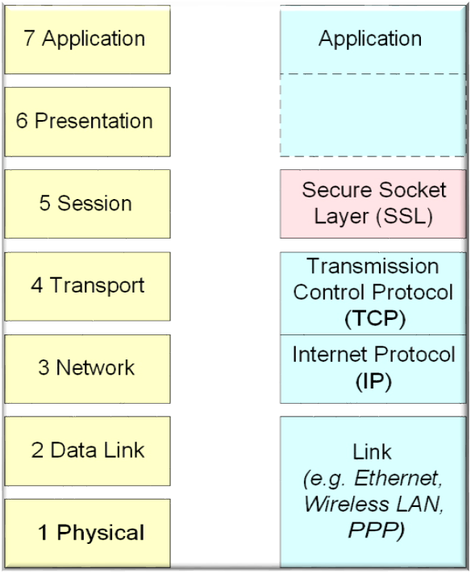
SSL/TLS Protocol Stack
ISO Open Systems Interconnect model
SSL runs beneath application layers. E.g. HTTP, FTP, SMTP etc
SSL runs above transport protocols such as TCP.

Slide 7
SSL/TLS Operation
Applicant
(Customer Client)
Verifier
(Merchant Server)
1. Negotiation of Security Options (Brief)
2. Merchant Authenticates Self to Customer
Uses a Digital Certificate
Customer Authentication is Optional and Uncommon

Slide 8
SSL/TLS Operation
Applicant
(Customer Client)
Verifier
(Merchant Server)
3. Client Generates Random Session Key
Client Sends Key to Server Encrypted
with Public Key Encryption
4. Ongoing Communication with Confidentiality
and Merchant Digital Signatures

Slide 9

Virtual Private Network (VPN)
Server
Internet
Host-to-Host VPN
Hosts can communicate
Directly with each other
Client-Server
Client-Client

Slide 10
Virtual Private Network (VPN)
Site-to-Site
VPN
Protected
Server
VPN
Server
Internet
VPN
Server
Protected
Server
Corporate
Site A
Corporate
Site B
Remote
Access
VPN
Remote
Access
VPN
Remote
Customer or
Supplier PC
Remote
Corporate PC

Slide 11
SSL/TLS VPNs
Has Grown in popularity for remote access
  Easy to implement
    Webservers already implement it
    Clients already have browsers
    If only using HTTP, very easy
    Has Become popular

Slide 12
SSL/TLS VPNs
Has Grown in popularity for remote access
  SSL/TLS gateways at sites allow more
    Single point of encryption for access to multiple webservers
    Output from some applications, such as Outlook and Outlook express, are “webified” so that they can be delivered to browsers
    If browser will accept a downloaded add-in program, can get access to even more applications

Slide 13
Point-to-Point Protocol (PPP) and RADIUS for Dial-Up Remote Access
Public Switched
Data
Network
Remote
Corporate PC
2. OK?
Dial-Up
Connection
1. Login
Username
And Password
RADIUS
Server
RAS 1
Remote
Corporate PC
2. OK?
Corporate
Site A
Dial-Up
Connection
RAS 2
RAS = Remote Access Server

Slide 14
Point-to-Point Protocol (PPP) and RADIUS for Dial-Up Remote Access
Remote
Corporate PC
Dial-Up
Connection
3. OK
4. Welcome
RADIUS
Server
RAS 1
Remote
Corporate PC
Public Switched
Data
Network
3. No
Corporate
Site A
Dial-Up
Connection
4. Refuse
RAS 2

Slide 15
PPP Authentication
No Authentication
Is an Option
Server
Client

Slide 16
PPP Authentication
PAP Authentication
Authentication-Request Messages
(Send Until Response)
Authentication-Response Message
Server
Client
Poor Security: Usernames and Passwords
Are Sent in the Clear

Slide 17
PPP Authentication
CHAP Authentication
Challenge Message
Response Message
Hash (Challenge Message + Secret)
Server
Client
Server computes hash of challenge message plus secret
If equals the response message, authentication is successful

Slide 18
PPP Authentication
MS-CHAP Authentication
Challenge Message
Response Message
Hash (Challenge Message + Password)
Server
Client
CHAP, but with password as the secret.
Widely used because allows password authentication
Standard on Microsoft Windows client
Only as secure as password strength

Slide 19
PPP Authentication
EAP Authentication
Authenticate
Defer authentication;
Will provide more information
Server
Client
EAP defers authentication to a later process
Such as RADIUS authentication

Slide 20
PPP Encryption
IETF Specifies DES and 3DES for PPP encryption
Microsoft uses Microsoft Point-to-Point Encryption (MPPE) for its remote access servers
AES has been incorporated into PPP products

Slide 21
Point-to-Point Tunneling Protocol (PPP)
IP Protocol 47 (GRE) Data Connection
Local
ISP Access
(Not Secure)
Internet
RADIUS
Server
PPTP
RAS
Remote
Corporate
PC
ISP
PPTP
Access
Concentrator
TCP Port 1723
Supervisory
Connection
(Vulnerable)
Corporate
Site A

Slide 22
Point-to-Point Tunneling Protocol (PPP)
Direct connection between PC and RAS
IP Protocol 47 (GRE) Data Connection
Internet
RADIUS
Server
PPTP
RAS
Remote
Corporate
PC
TCP Port 1723
Supervisory
Connection
(Vulnerable)
Corporate
Site A

Slide 23
Layer 2 Tunneling Protocol (L2TP)
DSL Access
Multiplexer
(DSLAM)
with L2TP
Client
Running
PPP
Internal
Server
L2TP
RAS
L2TP Tunnel
DSL
Local
Network
Carrier Network
Note: L2TP does not provide security. It provides only tunneling.
L2TP recommends the use of IPsec for security.

Slide 24
IPsec Operation: Tunnel and Transport Modes
Transport Mode
Site
Network
Site
Network
Secure Connection
Extra
Software
Required
Security
in Site
Network
Security
in Site
Network
Extra
Software
Required
Secure on
the Internet

Slide 25
IPsec Operation: Tunnel and Transport Modes
Tunnel Mode
IPsec
Server
IPsec
Server
Site
Network
Site
Network
Tunneled
Connection
No
Security
in Site
Network
No
Security
in Site
Network
No
Extra
Software
No
Extra
Software
Secure on
the Internet

Slide 26
IPsec Operation: Tunnel and Transport Modes
Transport Mode
Destination IP Address
Is Actual Address;
Vulnerable to Scanning
Orig. IP
Hdr
IPsec
Hdr
Protected Packet
Data Field
Tunnel Mode
Destination IP Address is
IPsec Gateway Address
Host IP Address
Is not Revealed
New IP
Hdr
IPsec
Hdr
Protected
Original Packet

Slide 27
IPsec ESP and AH Protection
Confidentiality
Encapsulating
Security
Payload
IP
Header
ESP
Header
Protected
ESP
Trailer
Protocol = 50
Authentication and Message Integrity
Protocol = 51
Authentication
Header
IP
Header
Authentication
Header
Protected
Authentication and Message Integrity
No Confidentiality

Slide 28
Modes and Protections
 | ESP Confidentiality Authentication Integrity | AH Authentication Integrity
Transport Mode (End-to-End) | Possible | Possible
Tunnel Mode (IPsec Gateway to Gateway) | Possible | Possible

Slide 29
IPsec Security Associations
2. Security Association (SA)
for Transmissions from A to B
3. Security Association (SA)
For Transmission from B to A
(Can Be Different Than
A to B SA)
Party A
Party B
1. List of
Allowable
Security
Associations
1. List of
Allowable
Security
Associations
IPsec Policy Server

Slide 30
Establishing IPsec Security Associations Using IKE
Internet Key Exchange
Security Association
UDP Port 500
Party A
Party B
First establish IKE association and
protected session
Then create IPsec SAs within the
Protection of the IKE session.
IPsec SAs

Slide 31
Key-Hashed Message Authentication Codes (HMACs)
Shared Key
Original Plaintext
Hashing with MD5, SHA1, etc.
HMAC
Key-Hashed Message Authentication Code (HMAC)
Appended to Plaintext Before Transmission
HMAC
Original Plaintext
Note: There is no
encryption; only
hashing

Slide 32
Key-Hashed Message Authentication Codes (HMACs)
Receiver Redoes the HMAC Computation
On the Received Plaintext
Shared Key
Received Original Plaintext
Hashing with same algorithm.
Computed HMAC
Received HMAC
If computed and received HMACs are the same,
The sender must know the key and so is authenticated

Slide 33
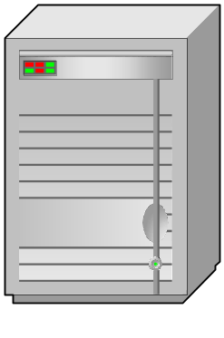

Kerberos Authentication System
Kerberos Server
Key Distribution Center
(K)
Abbreviations:
A = Applicant
V = Verifier
K = Kerberos Server
Verifier (V)
Applicant (A)

Slide 34
Kerberos Authentication System
Kerberos Server
Key Distribution Center
(K)
*TGT (Ticket-Granting
Ticket) is encrypted in a
way that only K can
decrypt. Contains
information that K
will read later.
1. Request for
Ticket-Granting
Ticket
**Key nA (Network
Login Key for A) is
encrypted with A’s
Master Key (Key mA).
In future interactions
with K, A will use nA
to limit the master
key’s exposure.
2. Response:
TGT*
Key nA**
Verifier (V)
Applicant (A)

Slide 35
Kerberos Ticket-Granting Service:
Part 1
Kerberos Server
Key Distribution Center
(K)
*Authenticator is A’s
IP address, user name,
and time stamp. This
authenticator is encrypted
with Key nA to prove that
A sent it.
Request Service
Ticket for V; TGT;
Authenticator*
encrypted with
Key nA
**Key AV is a
symmetric session
key that A will use
with V.
2. Response:
Key AV** encrypted
with Key nA;
Service Ticket
Verifier (V)
Applicant (A)

Slide 36
Kerberos Ticket-Granting Service:
Part 2
*Authenticator (Auth)
encrypted with Key AV.
**Service Ticket contains
Key AV encrypted with the
Verifier’s master key, Key mV.
Kerberos Server
Key Distribution Center
(K)
3. Request for Connection:
Auth*; Service Ticket**
5. Ongoing Communication with Key AV
Applicant (A)
Verifier (V)
4. V decrypts Service Ticket;
Uses Key AV to test Auth

Slide 37
Topics Covered
Cryptographic Systems
  Initial Hand-Shaking Phases
    Negotiation of parameters
    Mutual authentication
    Key exchange of symmetric session key
  Ongoing Communication
    Message-by-message confidentiality, authentication, and message integrity
  Occur at several layers

Slide 38
Topics Covered
Virtual Private Networks
  Secure communication over the Internet
  Site-to-Site VPNs
    Between security gateways at each site
    Must handle a large amount of intersite traffic
  Remote Access VPNs
    To connect an individual user to a site
  Host-to-Host (not mentioned in the text)

Slide 39
Topics Covered
SSL/TLS
  Works at the transport layer
  Protects SSL/TLS-aware applications
    Mostly HTTP
  Widely used in e-commerce
  Firms use it for remote access
    HTTP access
    Webified applications (e-mail)
    With downloaded client program, even more

Slide 40
Topics Covered
SSL/TLS
  Negotiation of security parameters
  Server authenticates self to client using digital certificate (usually not mutual authentication)
  Client generates random session key, sends to server with public key exchange

Slide 41
Topics Covered
SSL/TLS has become very popular for remote access VPN service
  Built into browsers and servers already
  Users can access the network from any client
    Home PCs, internet cafés, kiosks, etc.

Slide 42
Topics Covered
Point-to-Point Tunneling Protocol (PPTP)
  PPTP Tunneling
    Encapsulates PPP frame within a packet
    Packet travels to the RAS over the Internet
    This allows end-to-end PPP frame transfer
    Placing a message in another message is called tunneling

Slide 43
Topics Covered
Point-to-Point Tunneling Protocol (PPTP)
  PPTP Security
    Based on PPP security
    Several forms of PPP authentication
      Some very weak
      EAP allows advanced options
    PPP confidentiality
      DES or MPPE (more recently, AES)

Slide 44
Topics Covered
Point-to-Point Tunneling Protocol (PPTP)
  PPTP uses two connections
    GRE connection for carrying PPP frames (secure)
    TCP Port 1723 supervisory connection (not secure!)
  PPTP gateways often get authentication data from a RADIUS server

Slide 45
Topics Covered
Layer 2 Tunneling Protocol
  Protocol for tunneling messages over the Internet
  Has not security of its own
    Assumes you will be using IPsec security at the internet layer

Slide 46
Topics Covered
IP Security (IPsec)
  Internet layer security
    Transparently protects all upper layers
    Dominates site-to-site security today
    The highest-security VPN
  Tunnel versus Transport Mode
    Gateway-to-gateway vs host-to-host
    Ease of installation vs higher security
    Tunnel mode dominates today

Slide 47
Topics Covered
IPsec
  ESP versus AH
    ESP dominates
    Both work with both tunnel and transport mode
  Security Associations
    Policy-based restrictions on security parameters in a connection
    Two end points first set up IKE session
      Within IKE protection, negotiate the SA

Slide 48
Topics Covered
IPsec
  Key-Hashed Message Authentication Codes (HMACs)
    Used for message-by-message authentication
    Created using hashing, which is much faster than the public key encryption used with digital signatures

Slide 49
Topics Covered
IPsec is Popular for Site-to-Site Networking
  In tunnel mode, no need to install software on individual clients and servers
    For remote access, however, need software and configuration on client PC
  Transparent to applications—no need to provide different applications differently

Slide 50
Topics Covered
Kerberos Cryptographic System
  Complete cryptographic system
    Known best for authentication
    Also does key exchange for subsequent confidential communication
  Elements
    Kerberos server
    Applicant
    Verifier

Slide 51
Topics Covered
Kerberos Cryptographic System
  Complete cryptographic system
  Authentication System (Initial Stage)
    Applicant gets a ticket-granting ticket
    Applicant gets a key to use during a session for use with the Kerberos server

Slide 52
Topics Covered
Kerberos Cryptographic System
  Ticket-Granting Service
    Applicant sends ticket-granting ticket and name of a verifier to which it would like to connect
    Kerberos server sends back a symmetric session key to use with the verifier
    Kerberos server also sends the applicant a service ticket, which the applicant sends to the verifier
    The service ticket gives the verifier the symmetric session key to use with the applicant

